Slide 1
Designing CNN’s

Slide 2
Architecture design
Designing the architecture of a model involves choosing the types of layers and the way they are arranged and connected to each other.
There are infinitely many ways one can design a network.
Designing a good model usually involves a lot of trial and error.
It is still more of an art than science, and people have their own ways of designing models.
'folk wisdom'

Slide 3
Architecture design
How do you decide on the size of the kernels in the convolutional layers?
Short answer: 3x3 and 1x1 kernels usually work the best. They might sound too small, but you can stack 3x3 kernels on top of each other to achieve a larger receptive field.
A 1x1 filter is, in fact, a 1x1xN filter where N is the number of input channels. You can think of them as channel-wise dense layers that learn cross-channel features.
Combining 1x1 filters with 3x3 filters can help build very efficient models. This pattern is at the heart of many convolutional neural network architectures, including Inception family models, and MobileNets.

Slide 4
Other parameters
How to choose the sliding window step size, also known as the stride?
Choose one (1) if you want to preserve the spatial resolution of the activations, choose two (2) if you want to downsample.
How to choose pooling parameters?
Max pooling with a pooling size of 2x2 usually works fine.
How to choose the type of activation functions?
Short answer: choose ReLU except for the output layer.
What type of regularization techniques should I use?
Short answer: use dropout or Batchnormalization
What should be the batch size?
A batch size of 32 usually works fine for image recognition tasks. If the gradient is too noisy, you might try a bigger batch size. If you feel like the optimization gets stuck in local minima or if you run out of memory, then a smaller batch size would work better.

Slide 5
More folk wisdom
In general, smaller kernel size is preferred over larger kernel size for convolutional layer to better extract useful features.
In general, kernel size of odd numbers are preferred over kernel size of even numbers.
Since the hidden layers of a CNN work as a feature extractor, for more detailed content based on larger number of pixels would require larger number of filters. If localized differences are to receive greater attention, smaller number of filters may be useful.

Slide 6
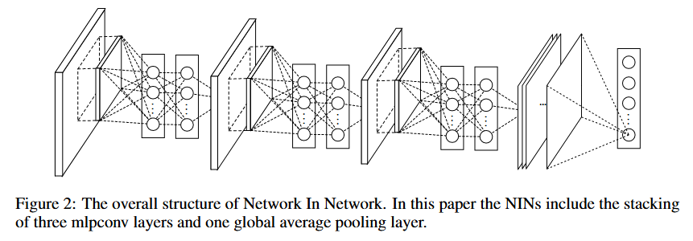
Yet more folk wisdom
Use stacks of smaller receptive field convolutional layers instead of using a single large receptive field convolutional layers.
i.e. A stack of two 3x3 conv layers vs a single 7x7 conv layer.
Use 1x1 conv layers (Network in Network style) to reduce dimensionality.
https://arxiv.org/pdf/1312.4400.pdf

Slide 7
References
https://arxiv.org/abs/1512.00567
https://www.robots.ox.ac.uk/~vgg/research/deep_eval/
https://www.isikdogan.com/blog/how-to-design-a-convolutional-neural-network.html

